Slide 1
DATA STORYTELLING & STAKEHOLDER COMMUNICATION · TASK 4
Olist Sales Analytics
Turning 96,478 orders of raw e-commerce data into decisions the business can act on.
Devpal Singh Anand · INBT019627 · DAINB20626

Slide 2
Agenda
1
Executive Summary
6
Insight 3: Payment Behavior
2
Business Problem & Audience
7
Before / After Chart Improvements
3
KPI Scorecard
8
Dashboard Walkthrough (Power BI & Tableau)
4
Insight 1: Geographic Concentration
9
Recommendations
5
Insight 2: Delivery Speed Drives Reviews
OLIST SALES ANALYTICS
2

Slide 3
Executive Summary
Problem: Olist needs to understand revenue drivers, customer behavior, and logistics performance.
R$ 13.6M
38%
91.9%
3.1%
total revenue across 96,478 delivered orders
of revenue comes from São Paulo — a geographic concentration risk
on-time delivery; faster delivery is strongly associated with better review scores
repeat purchase rate — the business is one-time-purchase driven
Recommendation: Diversify marketing beyond SP, prioritize fast delivery, and build retention programs.
OLIST SALES ANALYTICS
3

Slide 4
Business Problem & Audience
BUSINESS PROBLEM
BUSINESS QUESTIONS ANSWERED
Why is revenue concentrated, and what drives customer satisfaction?
Which states / categories drive the most revenue?
1
2
How does delivery speed affect customer reviews?
AUDIENCE
Olist Operations Manager
Needs actionable insights to optimize logistics and marketing spend.
What payment methods do customers prefer?
3
4
Are customers returning after their first purchase?
OLIST SALES ANALYTICS
4

Slide 5
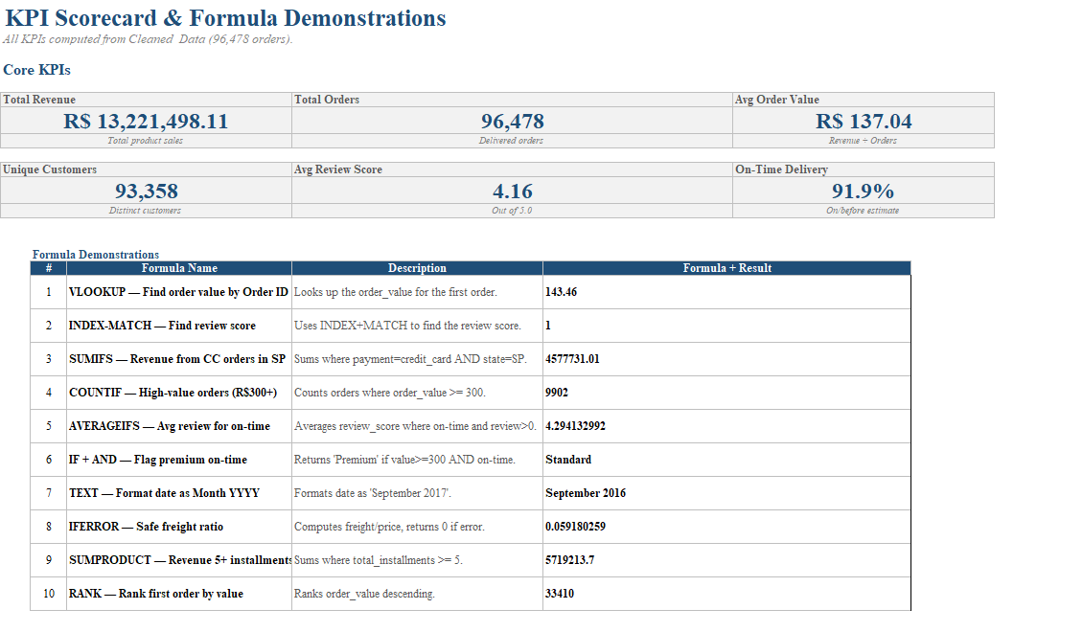
KPI Scorecard
R$ 13,591,644
96,478
R$ 137.75
96,096
Total Revenue
Total Orders
Avg Order Value
Unique Customers
3.12%
4.09 / 5.0
91.89%
12.6 days
Repeat Purchase Rate
Avg Review Score
On-Time Delivery
Avg Delivery Time
Excel KPI Scorecard with live formulas — all values reference the Cleaned_Data table
OLIST SALES ANALYTICS
5

Slide 6
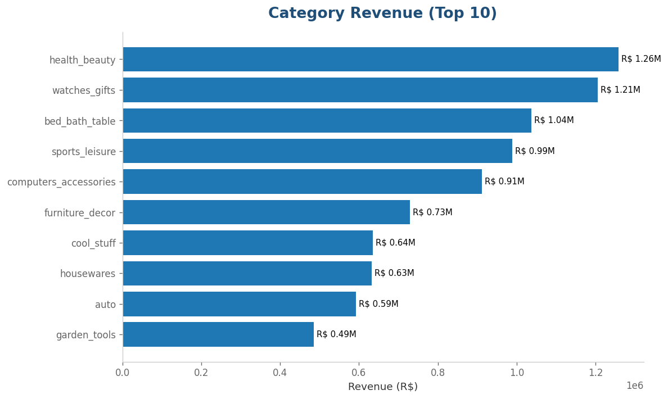
INSIGHT 1
Geographic Concentration
CONTEXT
São Paulo state generates 38% of total revenue (R$ 5.07M).
INSIGHT
Revenue is heavily concentrated in one region.
IMPLICATION
If SP experiences a logistics disruption, 38% of revenue is at risk.
RECOMMENDATION
Diversify marketing spend to grow RJ, MG, and RS states.
Tableau — Revenue by Category (showing concentration)
OLIST SALES ANALYTICS
6

Slide 7
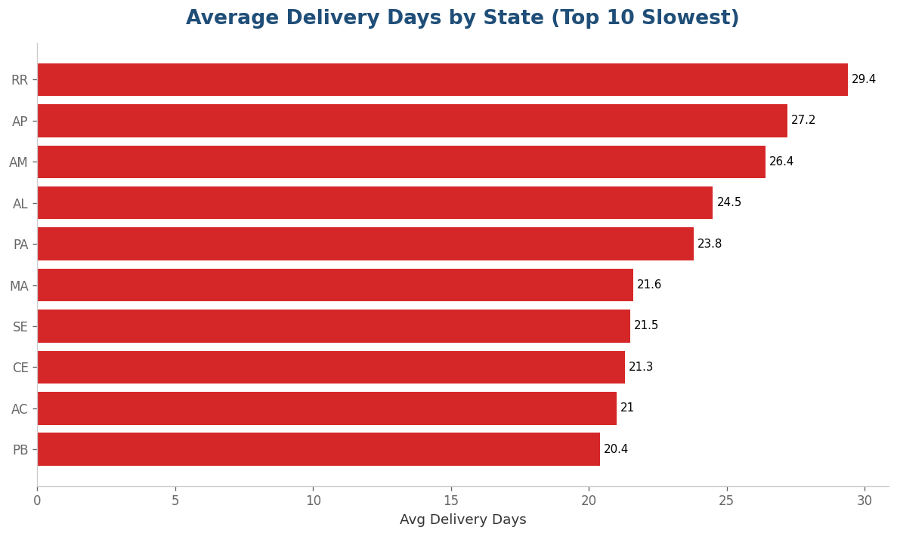
INSIGHT 2
Delivery Speed Drives Reviews
CONTEXT
91.9% of orders arrive on time. Average delivery takes 12.6 days.
INSIGHT
Faster delivery is strongly associated with better customer reviews.
IMPLICATION
Longer delivery times are strongly associated with lower review scores.
RECOMMENDATION
Invest in logistics to keep deliveries under 14 days.
4.42 ★
3.12 ★
0–7 DAY DELIVERY
22+ DAY DELIVERY
Tableau — Average Delivery Days by State
OLIST SALES ANALYTICS
7

Slide 8
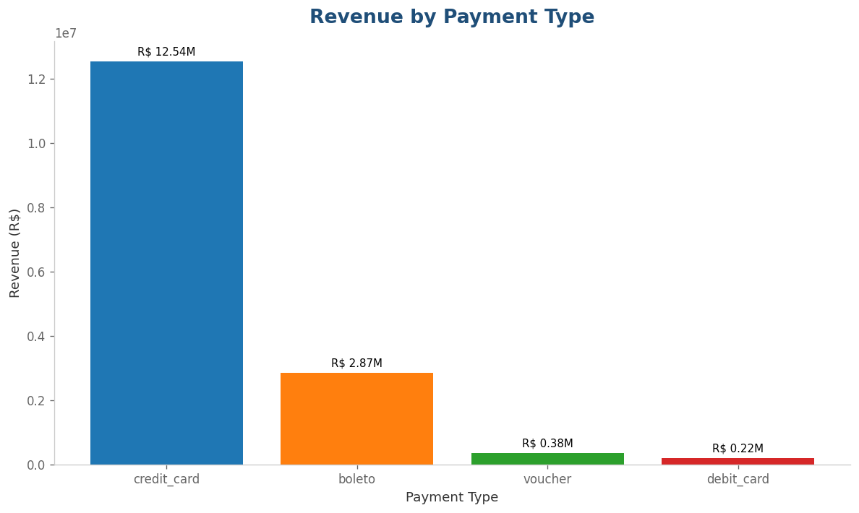
INSIGHT 3
Payment Behavior
CONTEXT
Credit card dominates with 78.3% of payment value.
INSIGHT
Brazilian consumers rely heavily on installments — 33.15% pay in full, 16.16% use 2 installments, and top plans go past 10.
IMPLICATION
Removing installment options would hurt conversion.
RECOMMENDATION
Ensure all payment flows support flexible installment plans.
Tableau — Revenue by Payment Type
OLIST SALES ANALYTICS
8

Slide 9
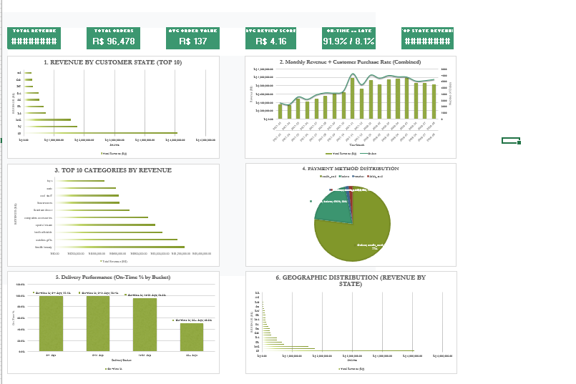
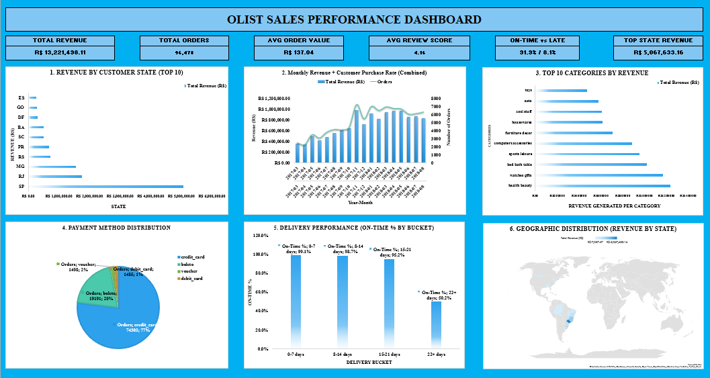
CHART IMPROVEMENT
Before / After: Excel Data Cleaning
BEFORE
AFTER
Takeaway: Raw data had trailing spaces, mixed casing, and text dates. The cleaned version uses TRIM, PROPER, and DATEVALUE formulas — all auditable, none hardcoded.
OLIST SALES ANALYTICS
9

Slide 10
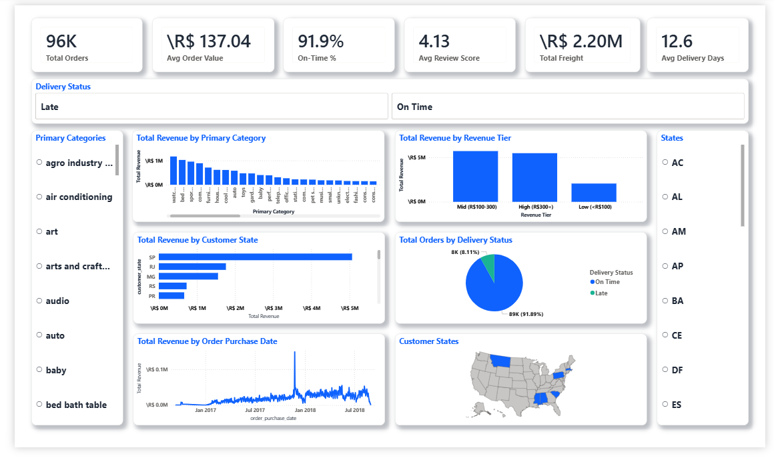
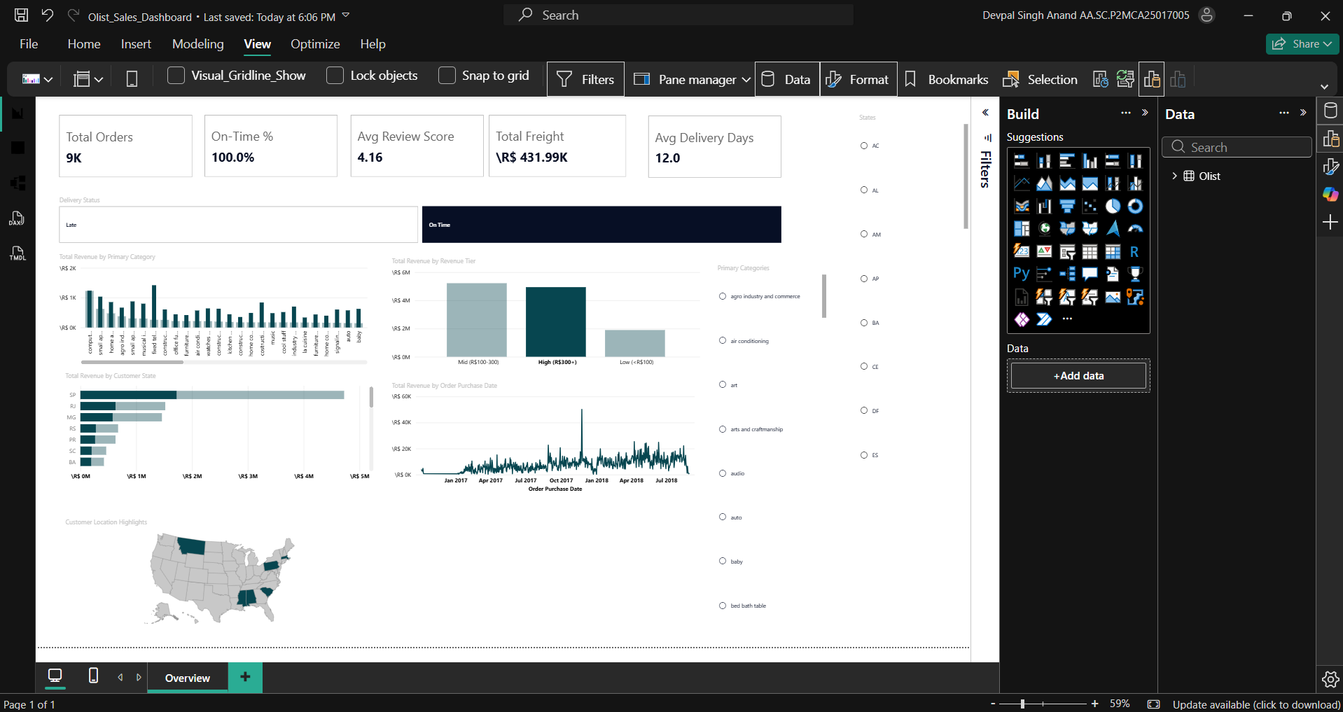
CHART IMPROVEMENT
Before / After: Power BI Dashboard
BEFORE
AFTER
Takeaway: The default Power BI visuals had no titles, default colors, and no data labels. The polished version adds takeaway titles, highlight colors, and clear labels.
OLIST SALES ANALYTICS
10

Slide 11
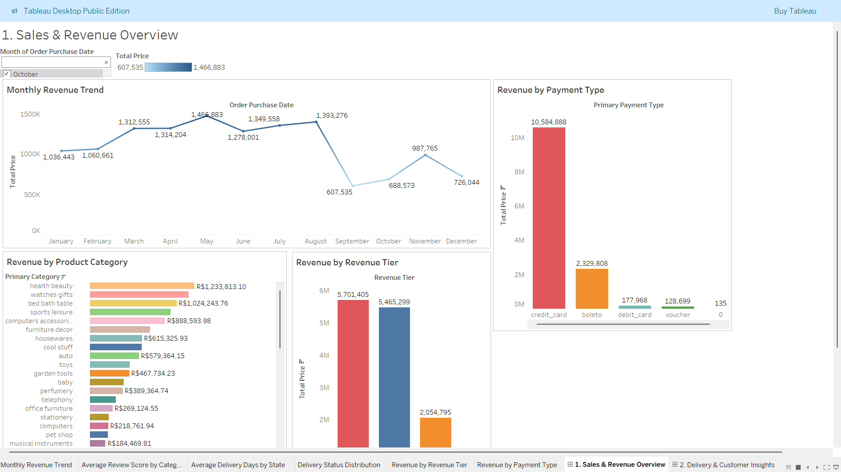
DASHBOARD 1 · TABLEAU
Sales & Revenue Overview
WHAT'S INSIDE
Category Revenue (Top 10)
Monthly Revenue Trend
Revenue by Payment Type
Revenue by Revenue Tier
All visuals are interactive — clicking any element filters the others. Built for the sales side of the business: which categories sell, how revenue trends over time, and how customers pay.
OLIST SALES ANALYTICS
11

Slide 12
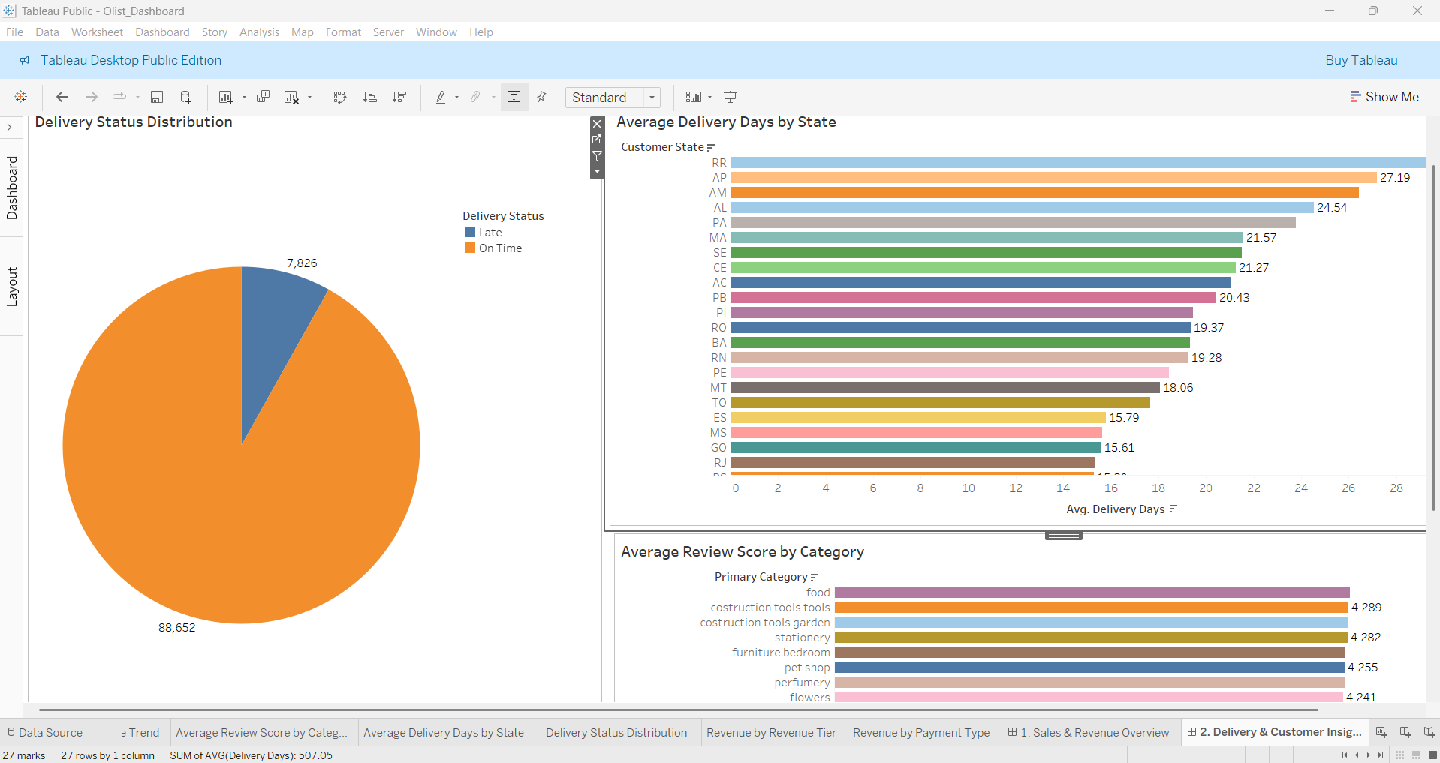
DASHBOARD 2 · TABLEAU
Delivery & Customer Insights
WHAT'S INSIDE
Average Delivery Days by State
Average Review Score by Category
Delivery Status Distribution
Revenue by Revenue Tier
This dashboard answers: where are deliveries slow, and which categories get the best reviews? Designed for the operations team.
OLIST SALES ANALYTICS
12

Slide 13
Recommendations
1
Diversify Geographic Focus
Shift 15–20% of marketing budget from SP to RJ, MG, RS to reduce concentration risk.
2
Prioritize Fast Delivery
Invest in logistics to keep deliveries under 14 days. Faster delivery is associated with higher review scores.
3
Build Retention Programs
3.1% repeat purchase rate indicates a significant retention opportunity. Launch loyalty and repeat-order incentives.
4
Maintain Installment Options
67% of credit card payments use 2+ installments — don't remove this feature.
5
Focus on Top 25% Product Categories
They generate 79% of revenue. Prioritize inventory and marketing for these.
OLIST SALES ANALYTICS
13

Slide 14
Thank You
Questions?
Devpal Singh Anand
INBT019627 · DAINB20626
Dataset: Olist Brazilian E-Commerce (96,478 orders)
Tools: SQLite · Excel · Power BI · Tableau

